Slide 1
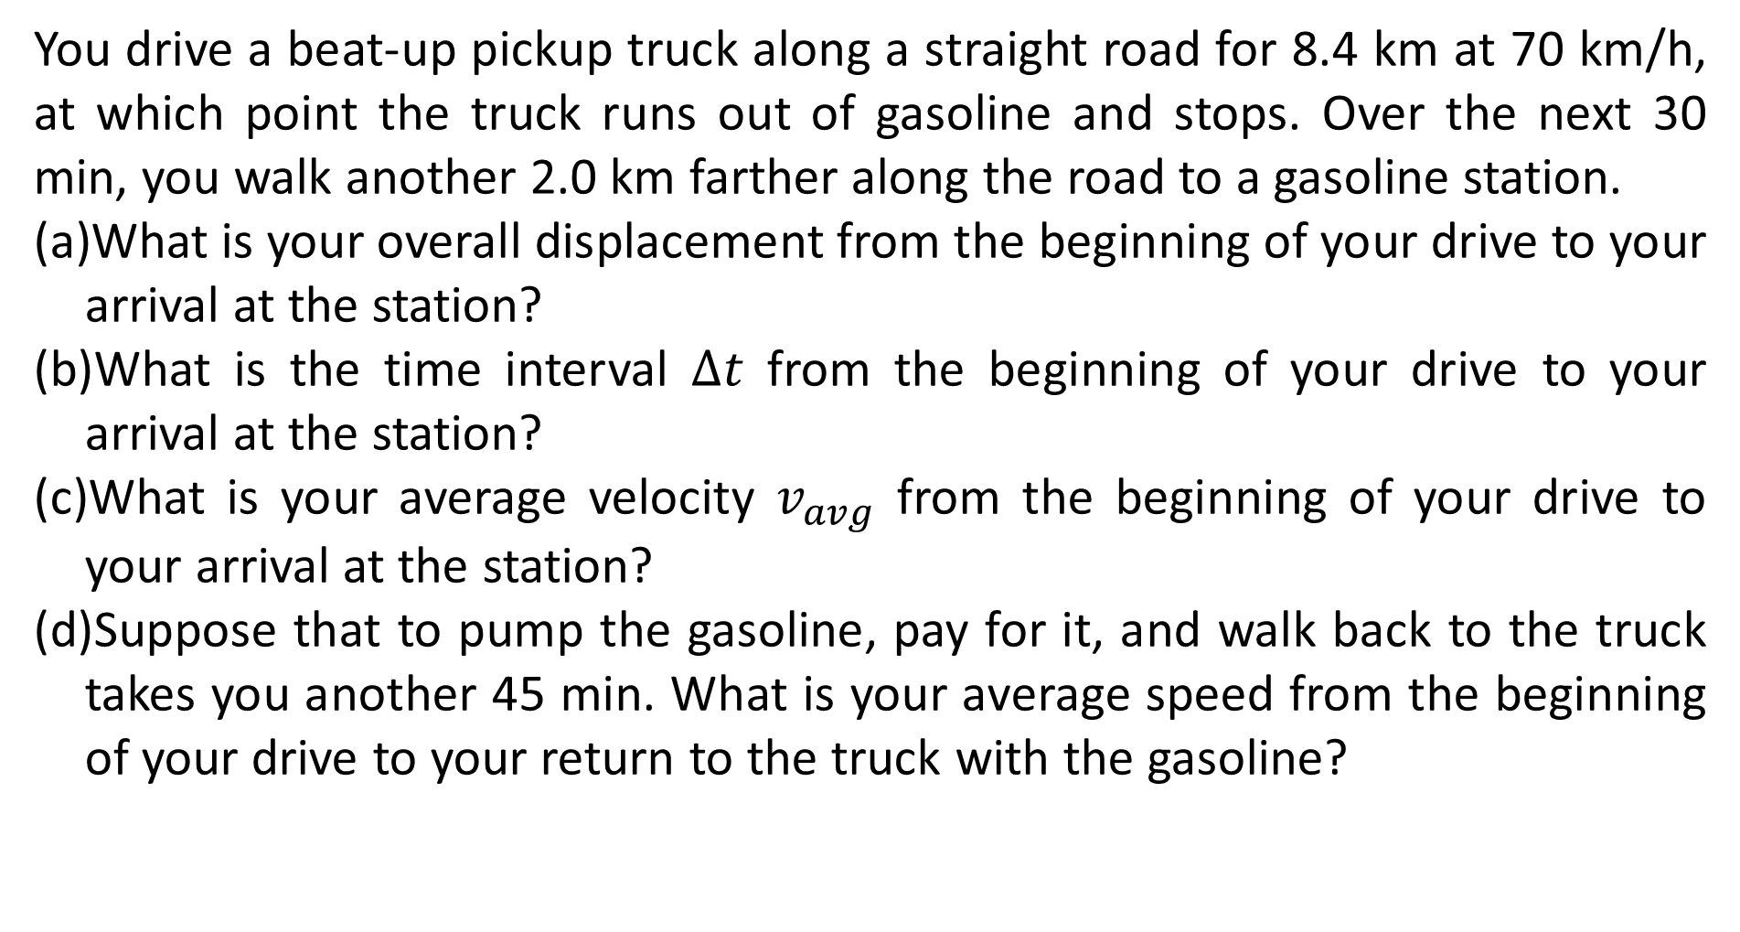
You drive a beat-up pickup truck along a straight road for 8.4 km at 70 km/h, at which point the truck runs out of gasoline and stops. Over the next 30 min, you walk another 2.0 km farther along the road to a gasoline station.
What is your overall displacement from the beginning of your drive to your arrival at the station?
What is the time interval $∆t$ from the beginning of your drive to your arrival at the station?
What is your average velocity $v_{avg}$ from the beginning of your drive to your arrival at the station?
Suppose that to pump the gasoline, pay for it, and walk back to the truck takes you another 45 min. What is your average speed from the beginning of your drive to your return to the truck with the gasoline?

Slide 2
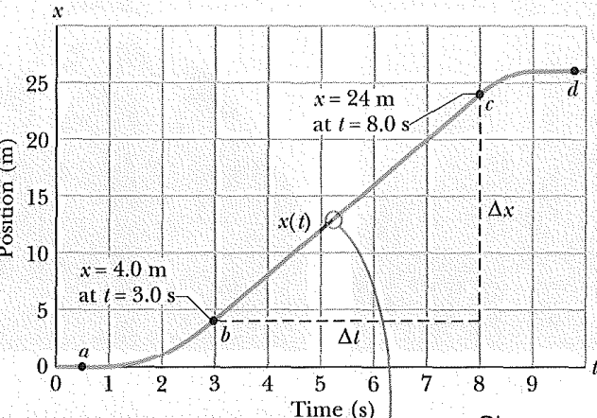
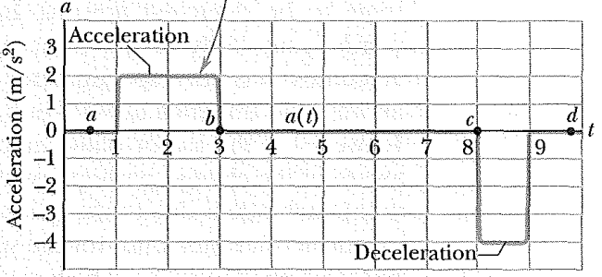
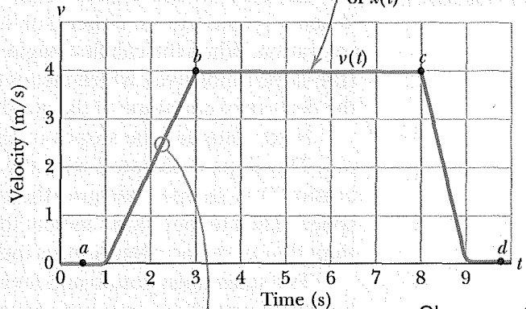
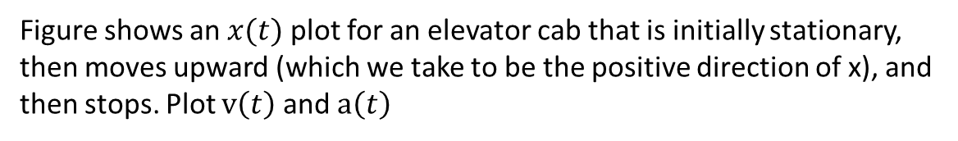
Figure shows an $x(t)$ plot for an elevator cab that is initially stationary, then moves upward (which we take to be the positive direction of x), and then stops. Plot $v\left(t\right)$ and $a\left(t\right)$

Slide 3
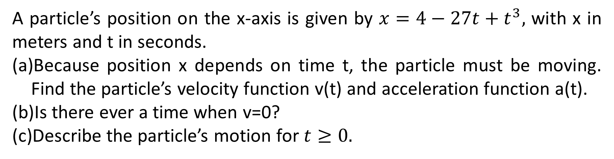
A particle’s position on the x-axis is given by $x=4−27t+t^{3},$ with x in meters and t in seconds.
Because position x depends on time t, the particle must be moving. Find the particle’s velocity function v(t) and acceleration function a(t).
Is there ever a time when v=0?
Describe the particle’s motion for $t≥0.$

Slide 4
A jet lands on an aircraft carrier at 140 mi/h (63 m/s).
What is its acceleration (assumed constant) if it stops in 2.0 s due to an arresting cable that snags the airplane and brings it to a stop?
If the plane touches down at position x_{i}=0, what is the final position of the plane?

Slide 5
A car traveling at a constant speed of 45.0 m/s passes a trooper hidden behind a billboard. One second after the speeding car passes the billboard, the trooper sets out from the billboard to catch it, accelerating at a constant rate of 3.00 m/s². How long does it take her to overtake the car?

Slide 6
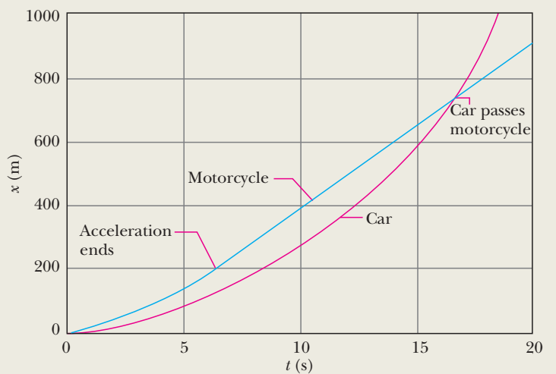
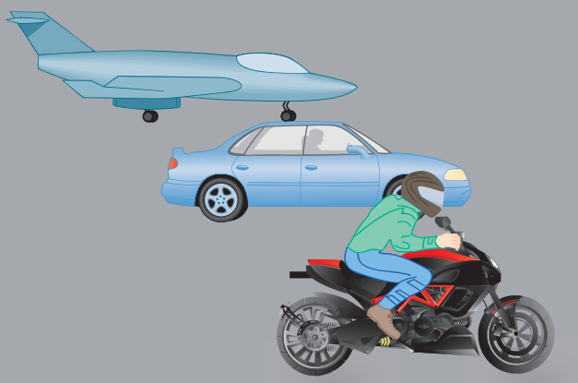
A popular web video shows a jet airplane, a car, and a motorcycle racing from rest along a runway (As in the Fig.). Initially the motorcycle takes the lead, but then the jet takes the lead, and finally the car blows past the motorcycle. Here let’s focus on the car and motorcycle and assign some reasonable values to the motion. The motorcycle first takes the lead because its (constant) acceleration am 8.40 m/s² is greater than the car’s (constant) acceleration ac 5.60 m/s², but it soon loses to the car because it reaches its greatest speed v_{m} 58.8 m/s before the car reaches its greatest speed v_{c} 106 m/s. How long does the car take to reach the motorcycle?
ANS: 16.6 S

Slide 7
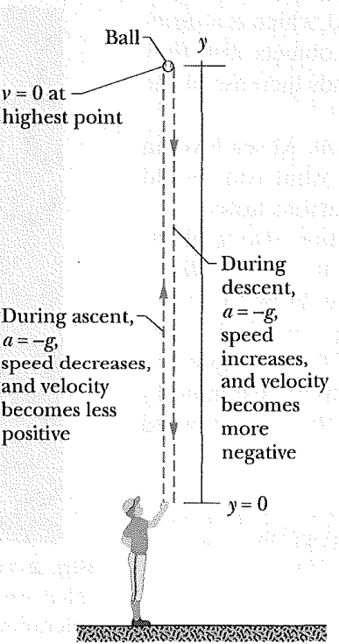
As in the figure, a pitcher tosses a baseball up along a y-axis, with an initial speed of 12 m/s.
How long does the ball take to reach its maximum height?
What is the ball’s maximum height above its release point?
How long does the ball take to reach a point 5.0 m above its release point?

